Slide 1
Behind Attrition
Income case study—— DS6306 Case study 2
Lihao Wang

Slide 2
About Dataset
The data set is built with 870 employee entries including but not limited
Job Satisfaction,
Monthly Income
Family Status factors.
Three department:
Human Resource
Research & Development
Sales
Notes:
DDSAnalytics 3 department 6 edu field 9 role

Slide 3
Questions
Factors
Influence on turnover
Classification
Demand of a model for future management
Jobs
Job specific trends needed paying attention
Analytics
Need of results to application

Slide 4
Quick Overview

Slide 5
Classification Model
Underlying logic
Usage of Naivebayes or other method to quantify.
Design
Usage of 70/30 cross validation
Chose of factors
Correlation
Notes:
Usage of Naivebayes or other method to quantify the possibility of factors like jobs and department

Slide 6
Top 3
Over Time
Marital Status
Job Involvement
0.272
A positive weak influence
0.197
A positive weak influence
-0.187
A negative weak influence

Slide 7
Quick Look in result
True rate score
Over 120 and reaches 129.7
Weak on true positive rate
As positive in population =140 (16%)

Slide 8
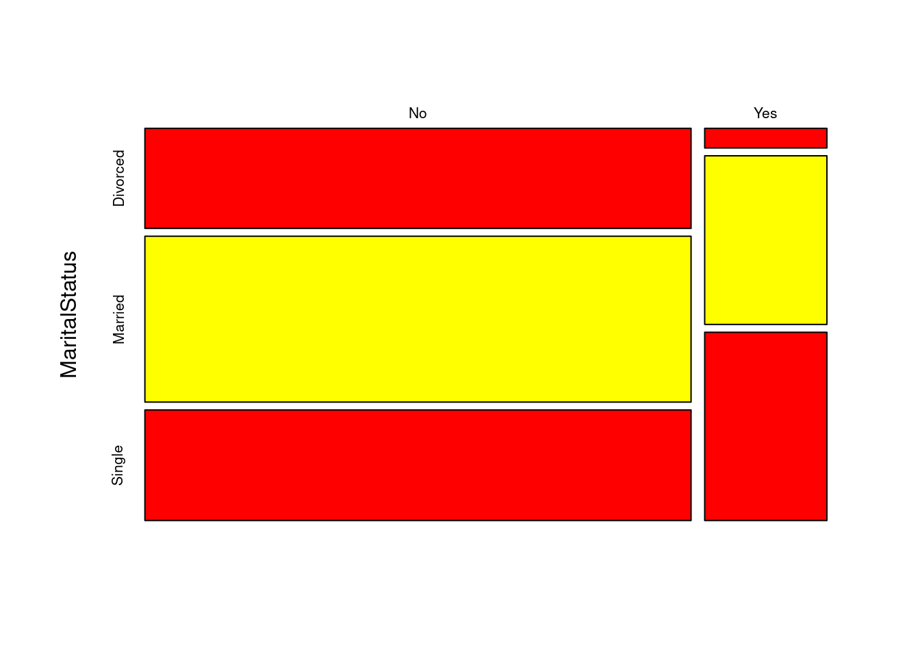
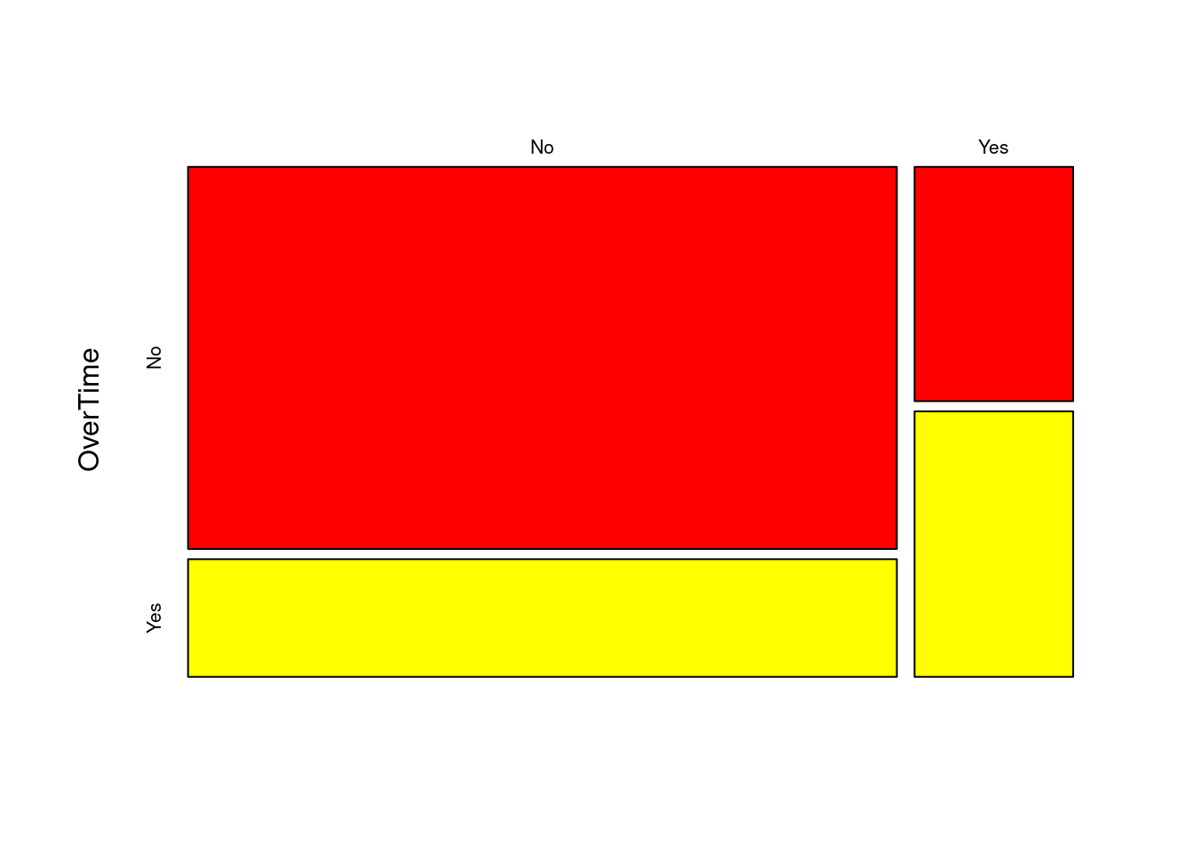
Performance of factors From MODEL

Slide 9
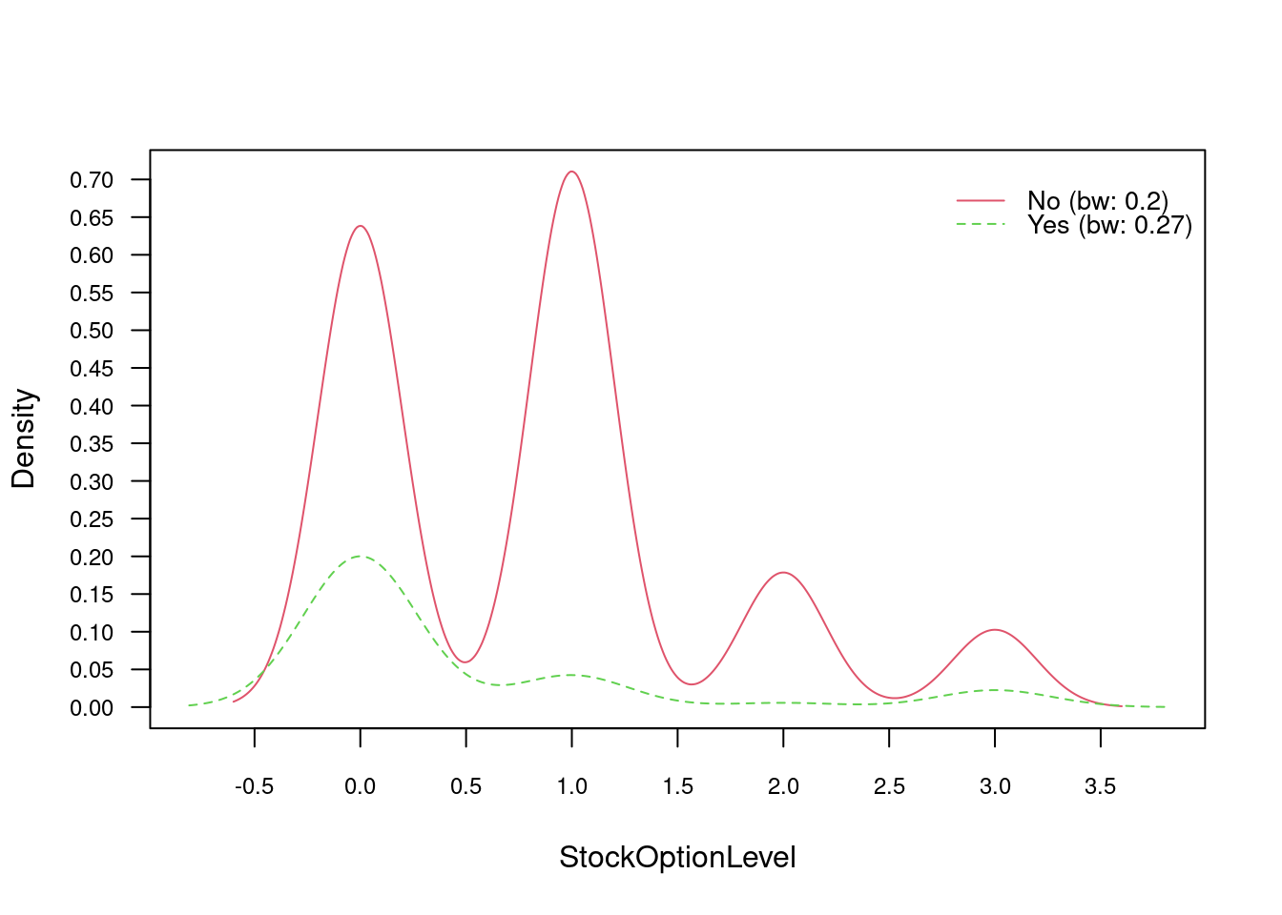
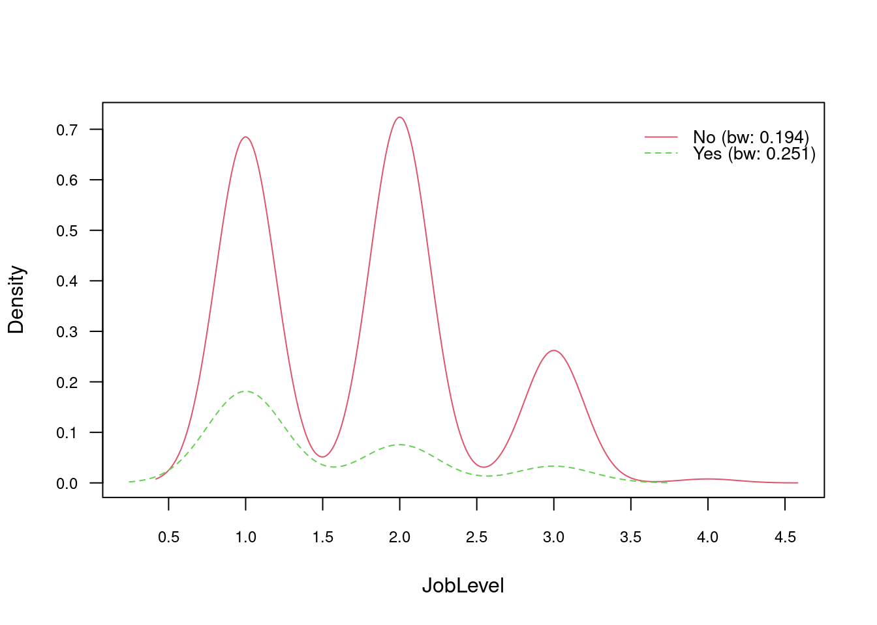
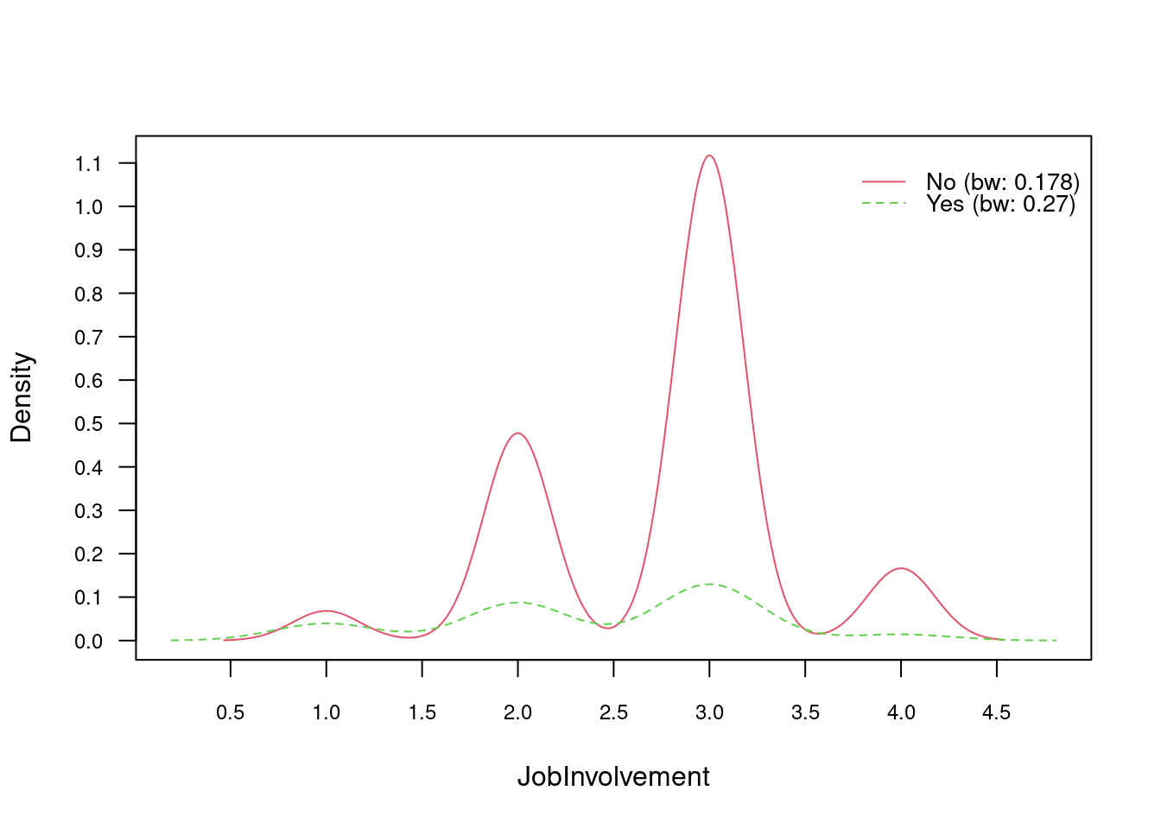
Performance of factors Con’t

Slide 10
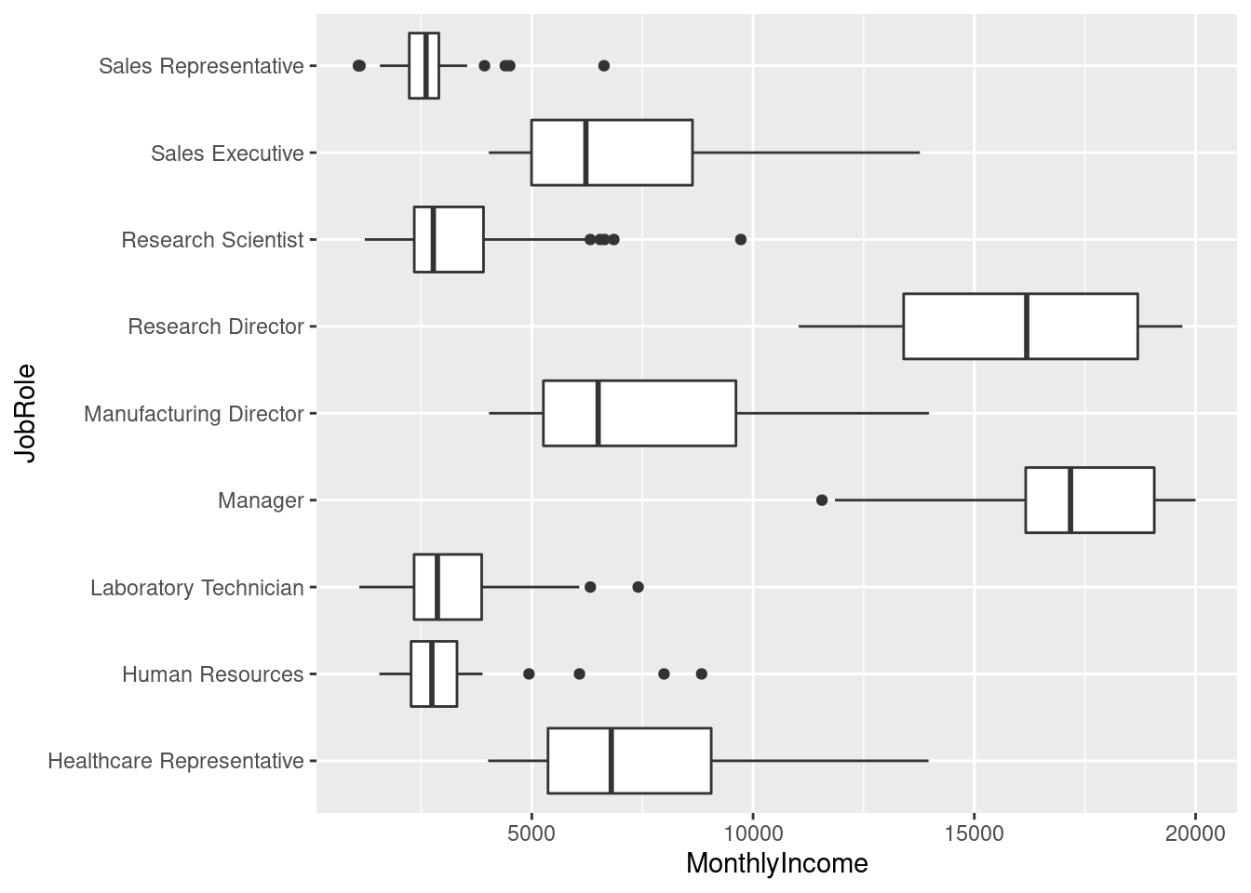
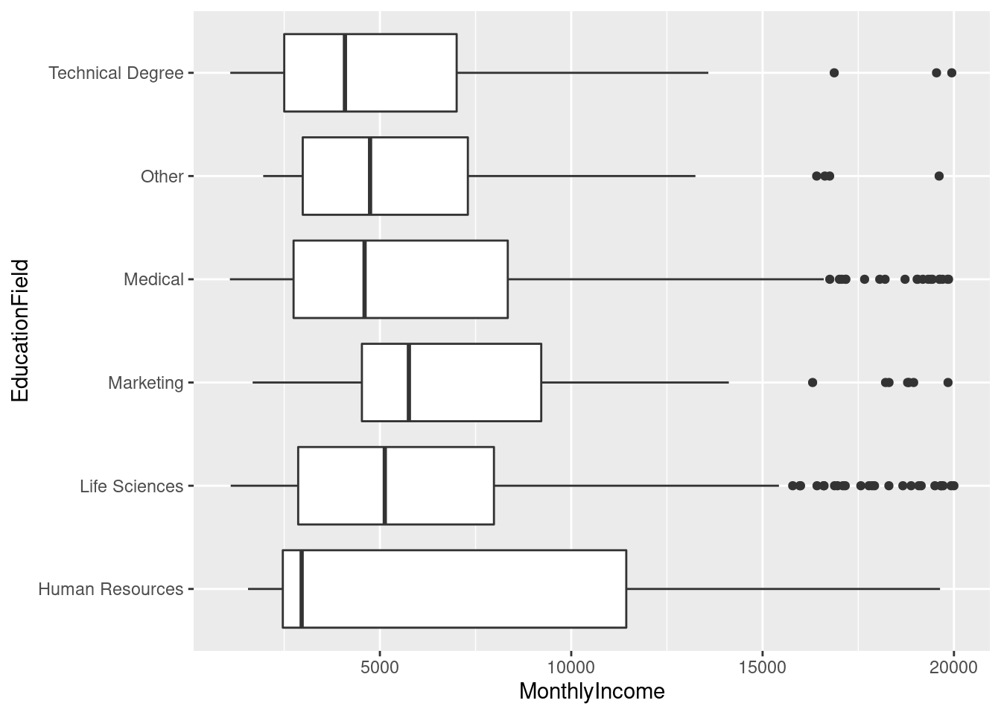
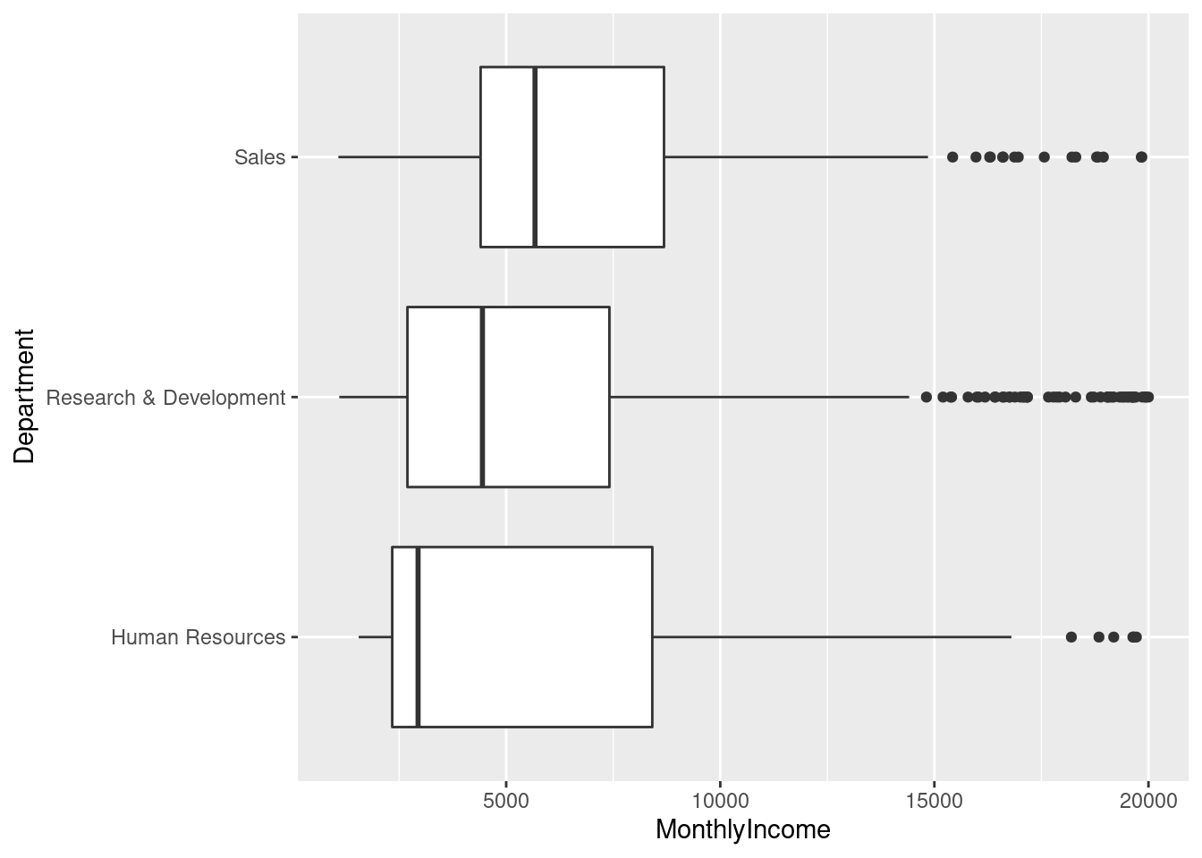
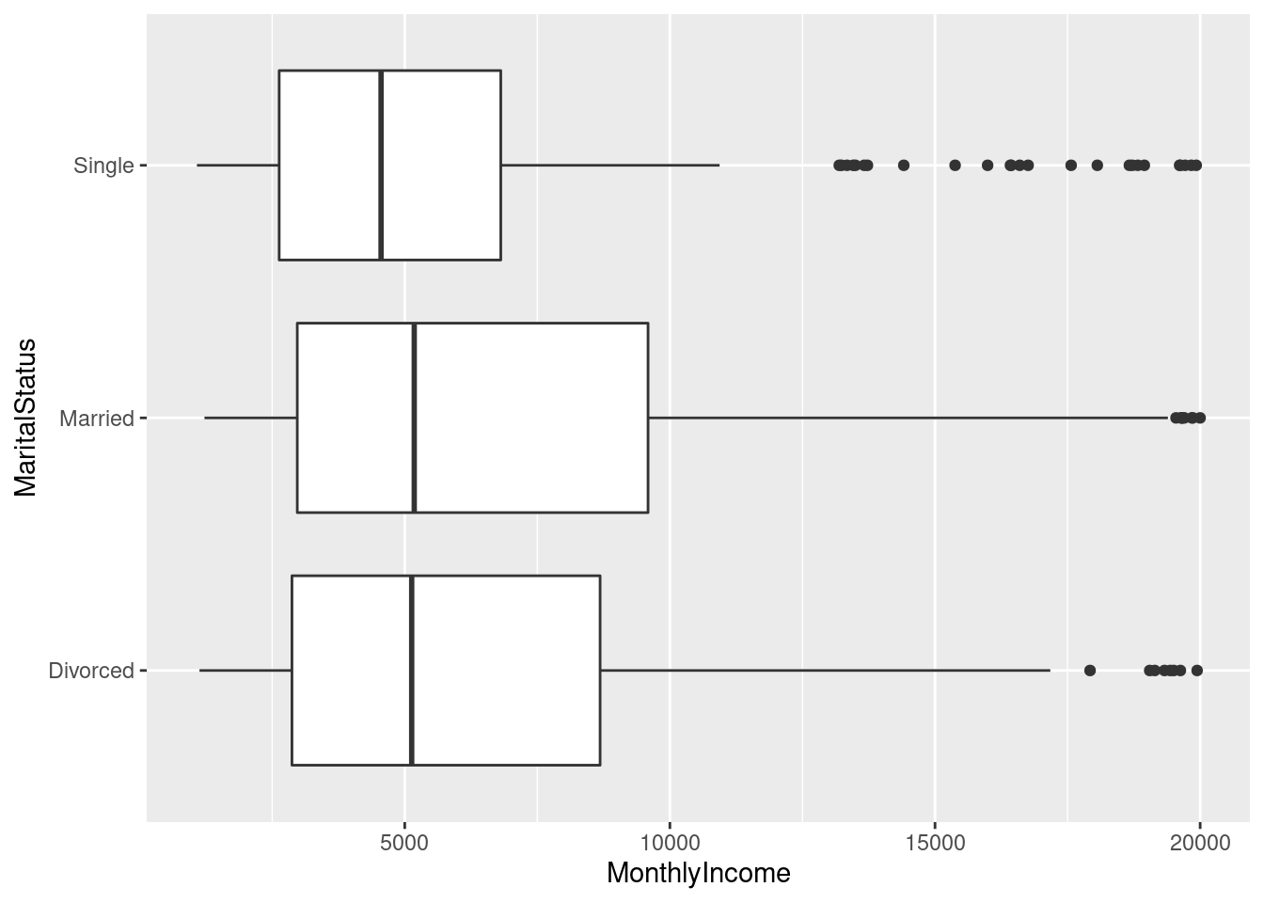

Slide 11
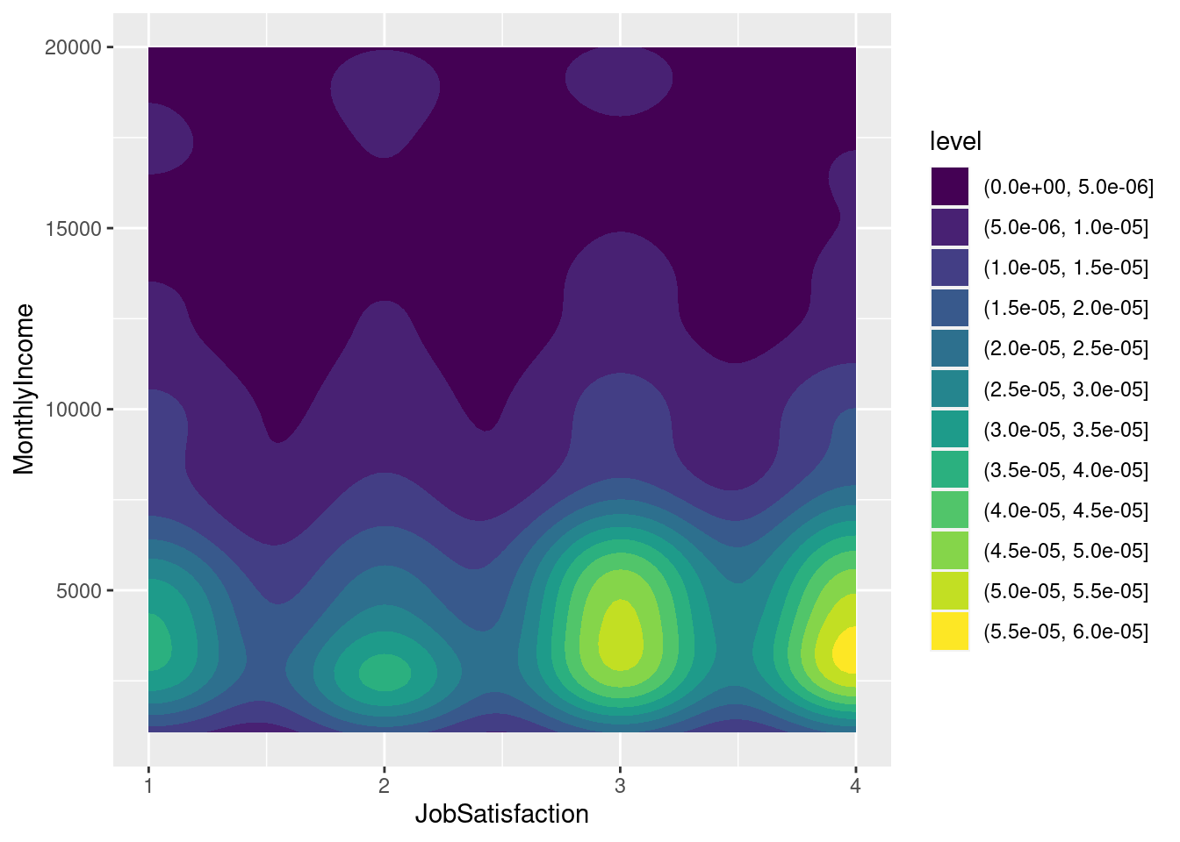

Slide 12
Thank you！
Lihao Wang
647-462-9413
harrywang@smu.edu

